Slide 1
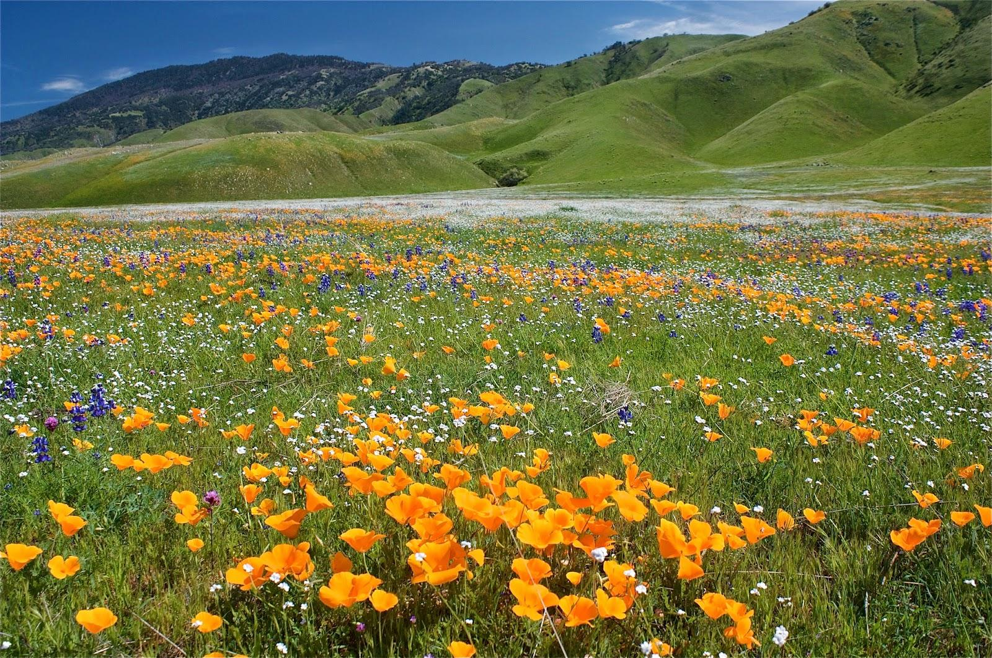
Climate drives transitions between dominant species in California Annual Grasslands
Evan Batzer¹, Carolyn Malmstrom², and Valerie Eviner¹
University of California, Davis
Michigan State University

Slide 2
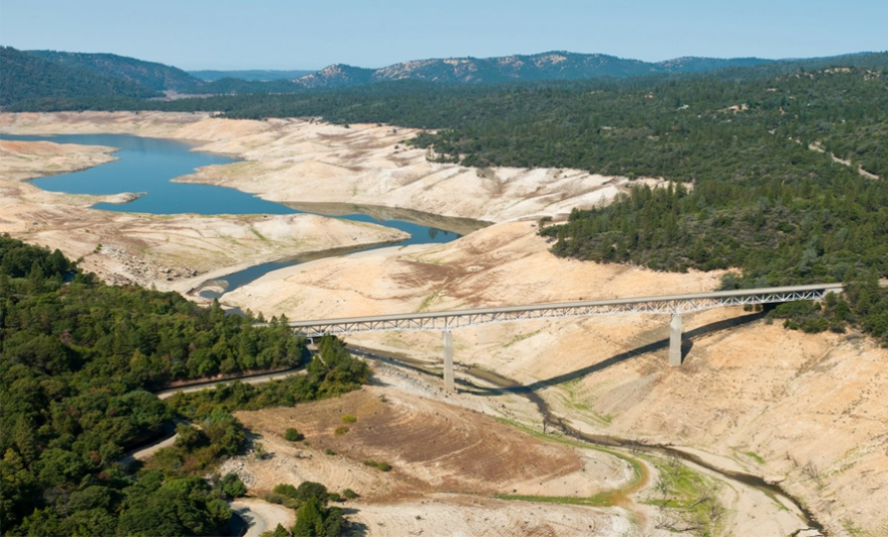
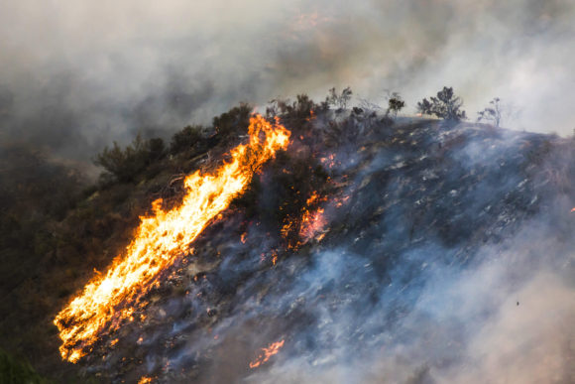
Climate Change and Land Management
Climate change is expected to act as a major stressor to many ecosystems
In California, an emphasis on increased frequency of extreme events, such as drought and heatwaves
Already showing signs of change?
2011 - 2017 drought in California the driest period on record

Slide 3
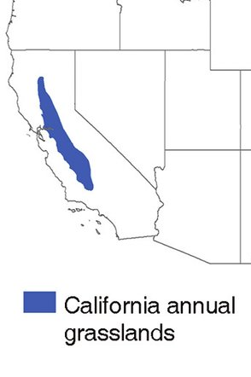
California Annual Grasslands
Conservation and Economic Importance:
>10% of state land area
Biodiversity hotspot
Use in agriculture and livestock production
Mediterranean system; vegetation must adapt to a long, hot summer with little precipitation
Extreme events may disrupt normal vegetation turnover and key ecosystem services
How do we manage under a changing climate?

Slide 4
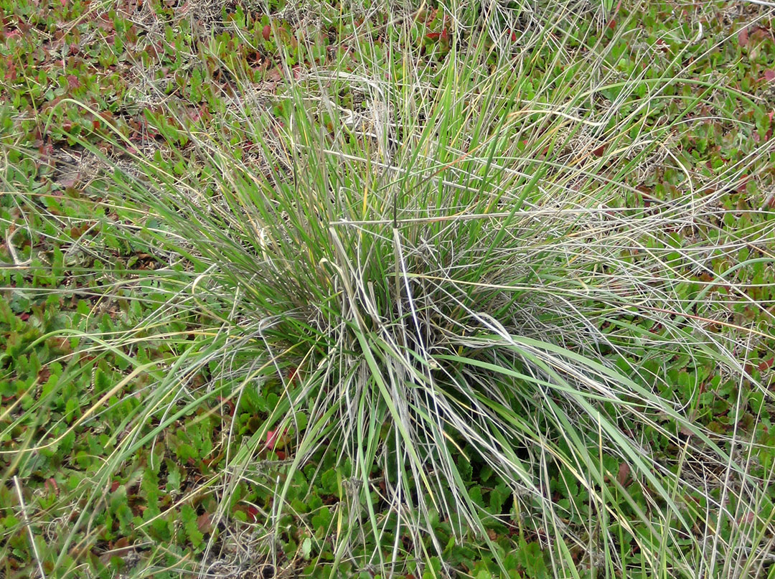
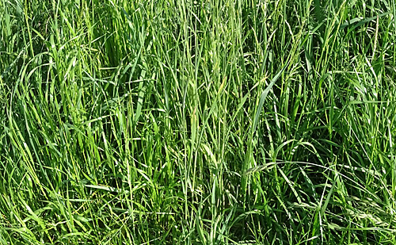
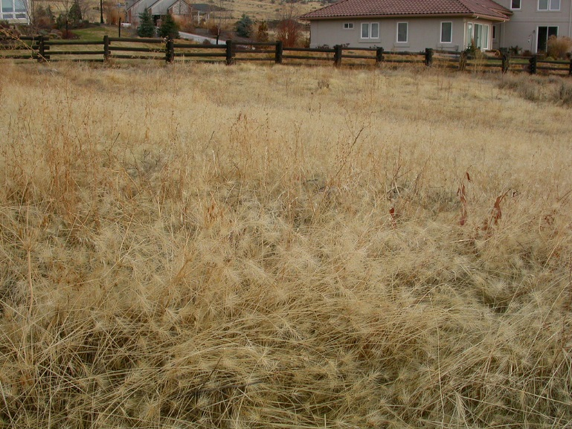
Species groups in annual grasslands
Management in California grasslands emphasizes the importance of plant species interactions and the role of climatic variation
Native Perennials
(Restoration Target)
Naturalized Annuals
(Dominant Across CA)
Invasive Annuals
(New Invaders)

Slide 5
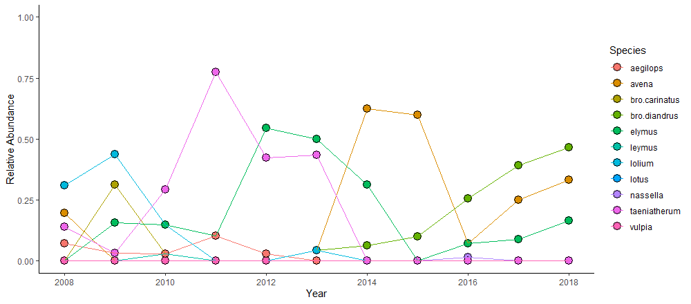
Nonequilibrium in California grasslands
Vegetation composition in California grasslands is highly variable; Communities rarely converge to a single type

Slide 6
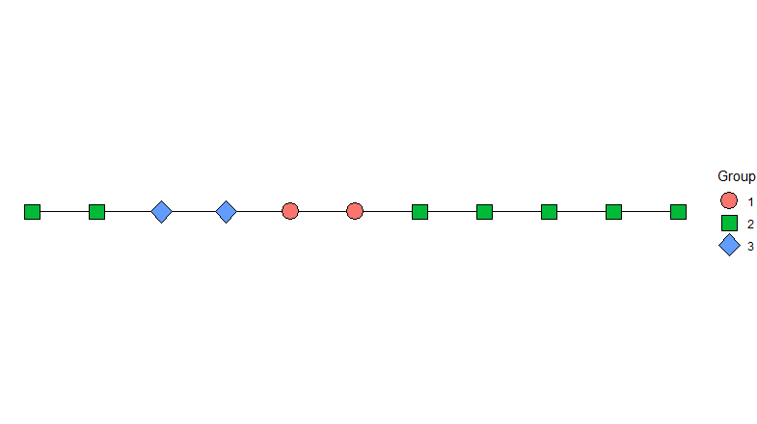
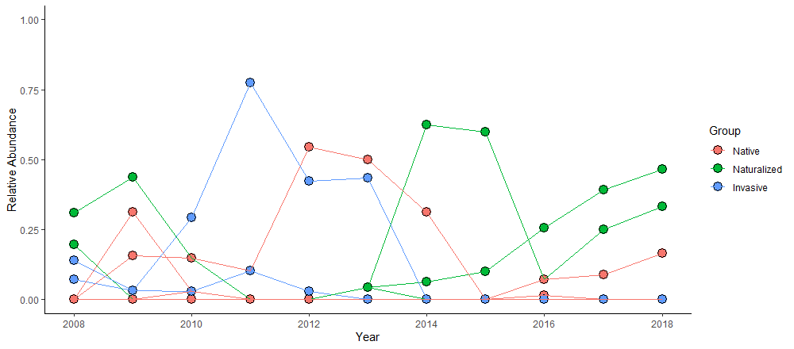
Characterizing vegetation change
A priori vegetation “states” can describe changes in dominant species, but inappropriately lump them together
Native
Naturalized
Invasive

Slide 7
State-transition models
Native
Naturalized
Invasive
1
State
1
State-transition models created using expert observations over time.
Problems:
Previous state assignments may not hold under novel conditions.
Often qualitative -- difficult to predict change.
Transition
3
2
3
2

Slide 8
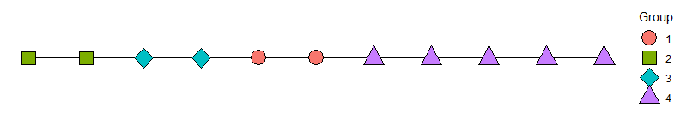
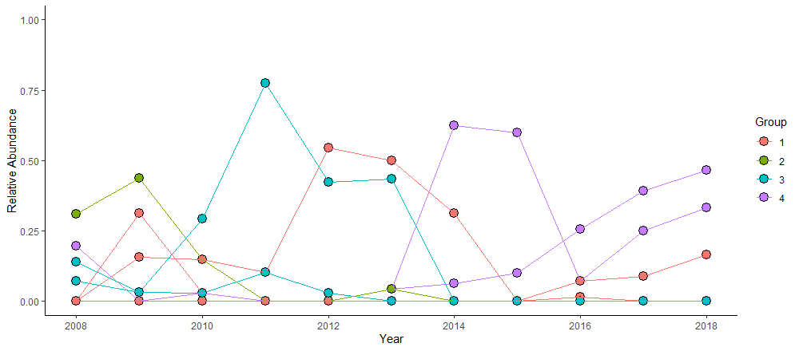
Computational approaches to vegetation clustering
Computer-based clustering may better classify vegetation “states” with correlated species abundances

Slide 9
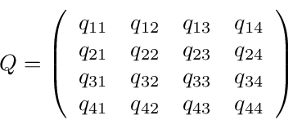
Multi-state (Markov) modeling
1
4
1
4
3
2
3
Direct quantification of transition probabilities and their relationship with environmental variables
2

Slide 10
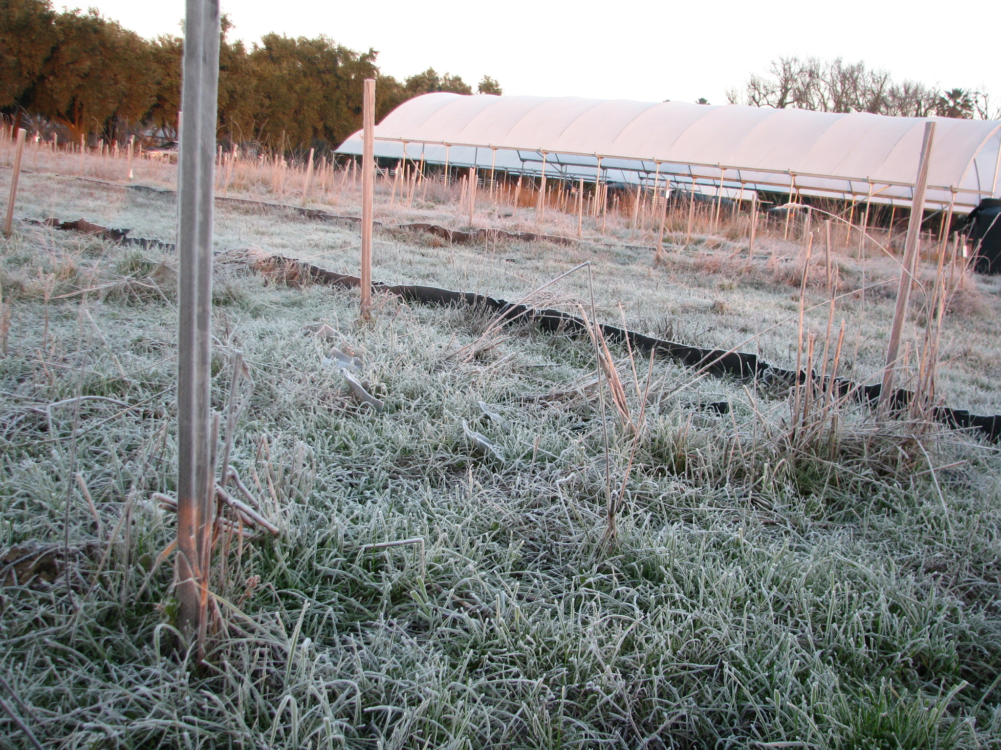
Under drought, what vegetation states best describe plant communities in California annual grasslands?
How does drought cause vegetation to transition between states?
3) How can quantitative state-transition models better guide restoration under global change?

Slide 11
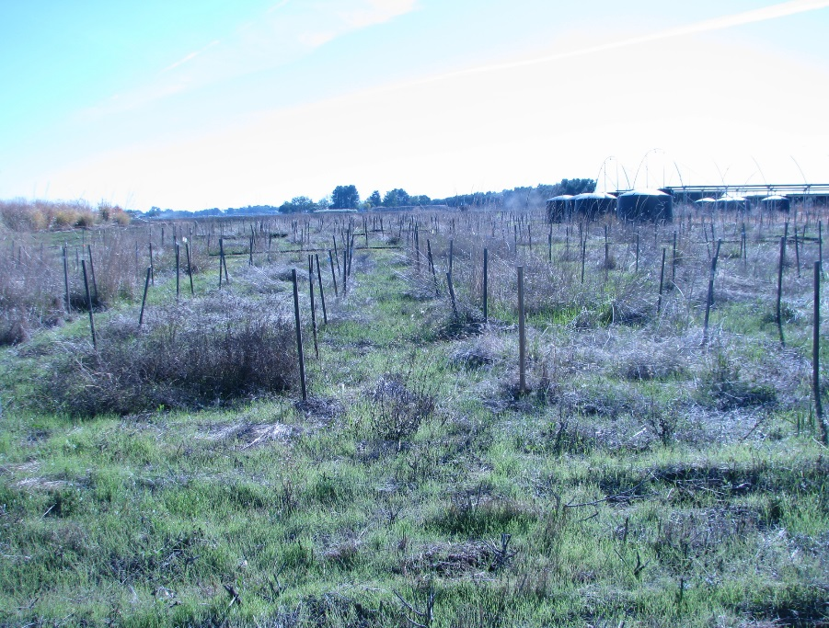
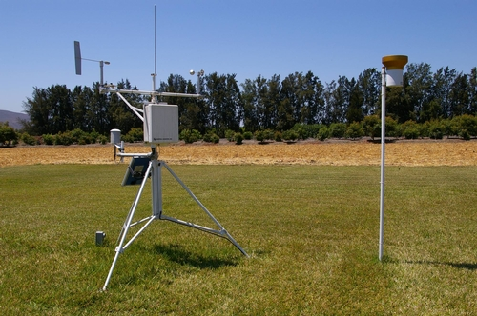
Experimental design
56 experimental plots established in Davis, California
3 Species Groups:
(N) Native species (Perennial grasses + forbs)
(A) Naturalized species (Annual grasses + forbs)
(I) Invasive species (Annual grasses)
Planted in full factorial combinations (1, 2, and 3 group mixtures)
I, N, A, I+A, N+A, N+I, N+I+A
Observed consistently from 2008 to present (N = 560)
Measurements of plant species composition, areal cover throughout the growing season
Environmental data provided from a local climate monitoring station

Slide 12
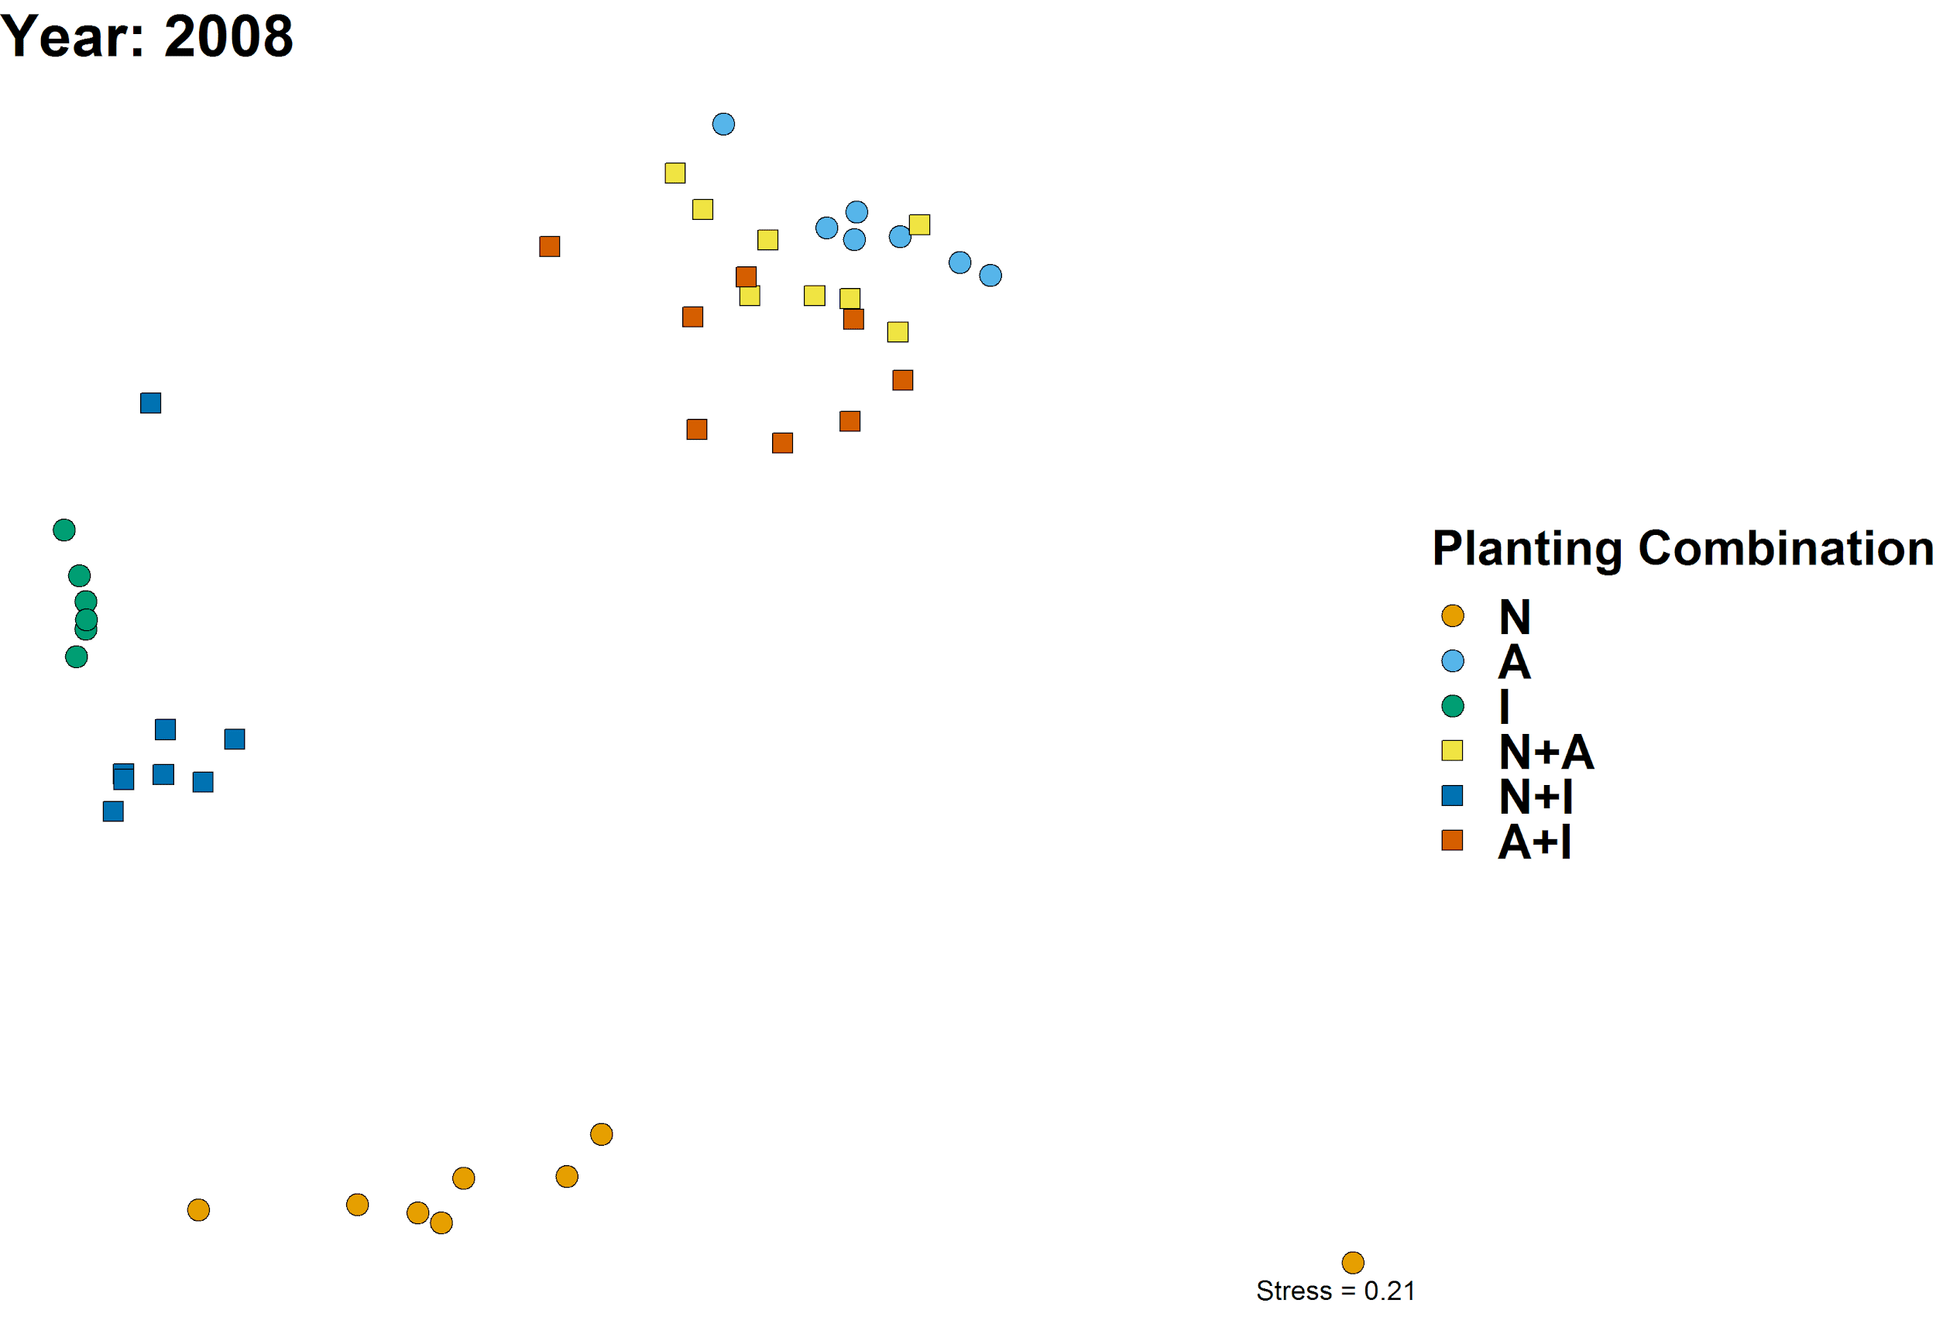
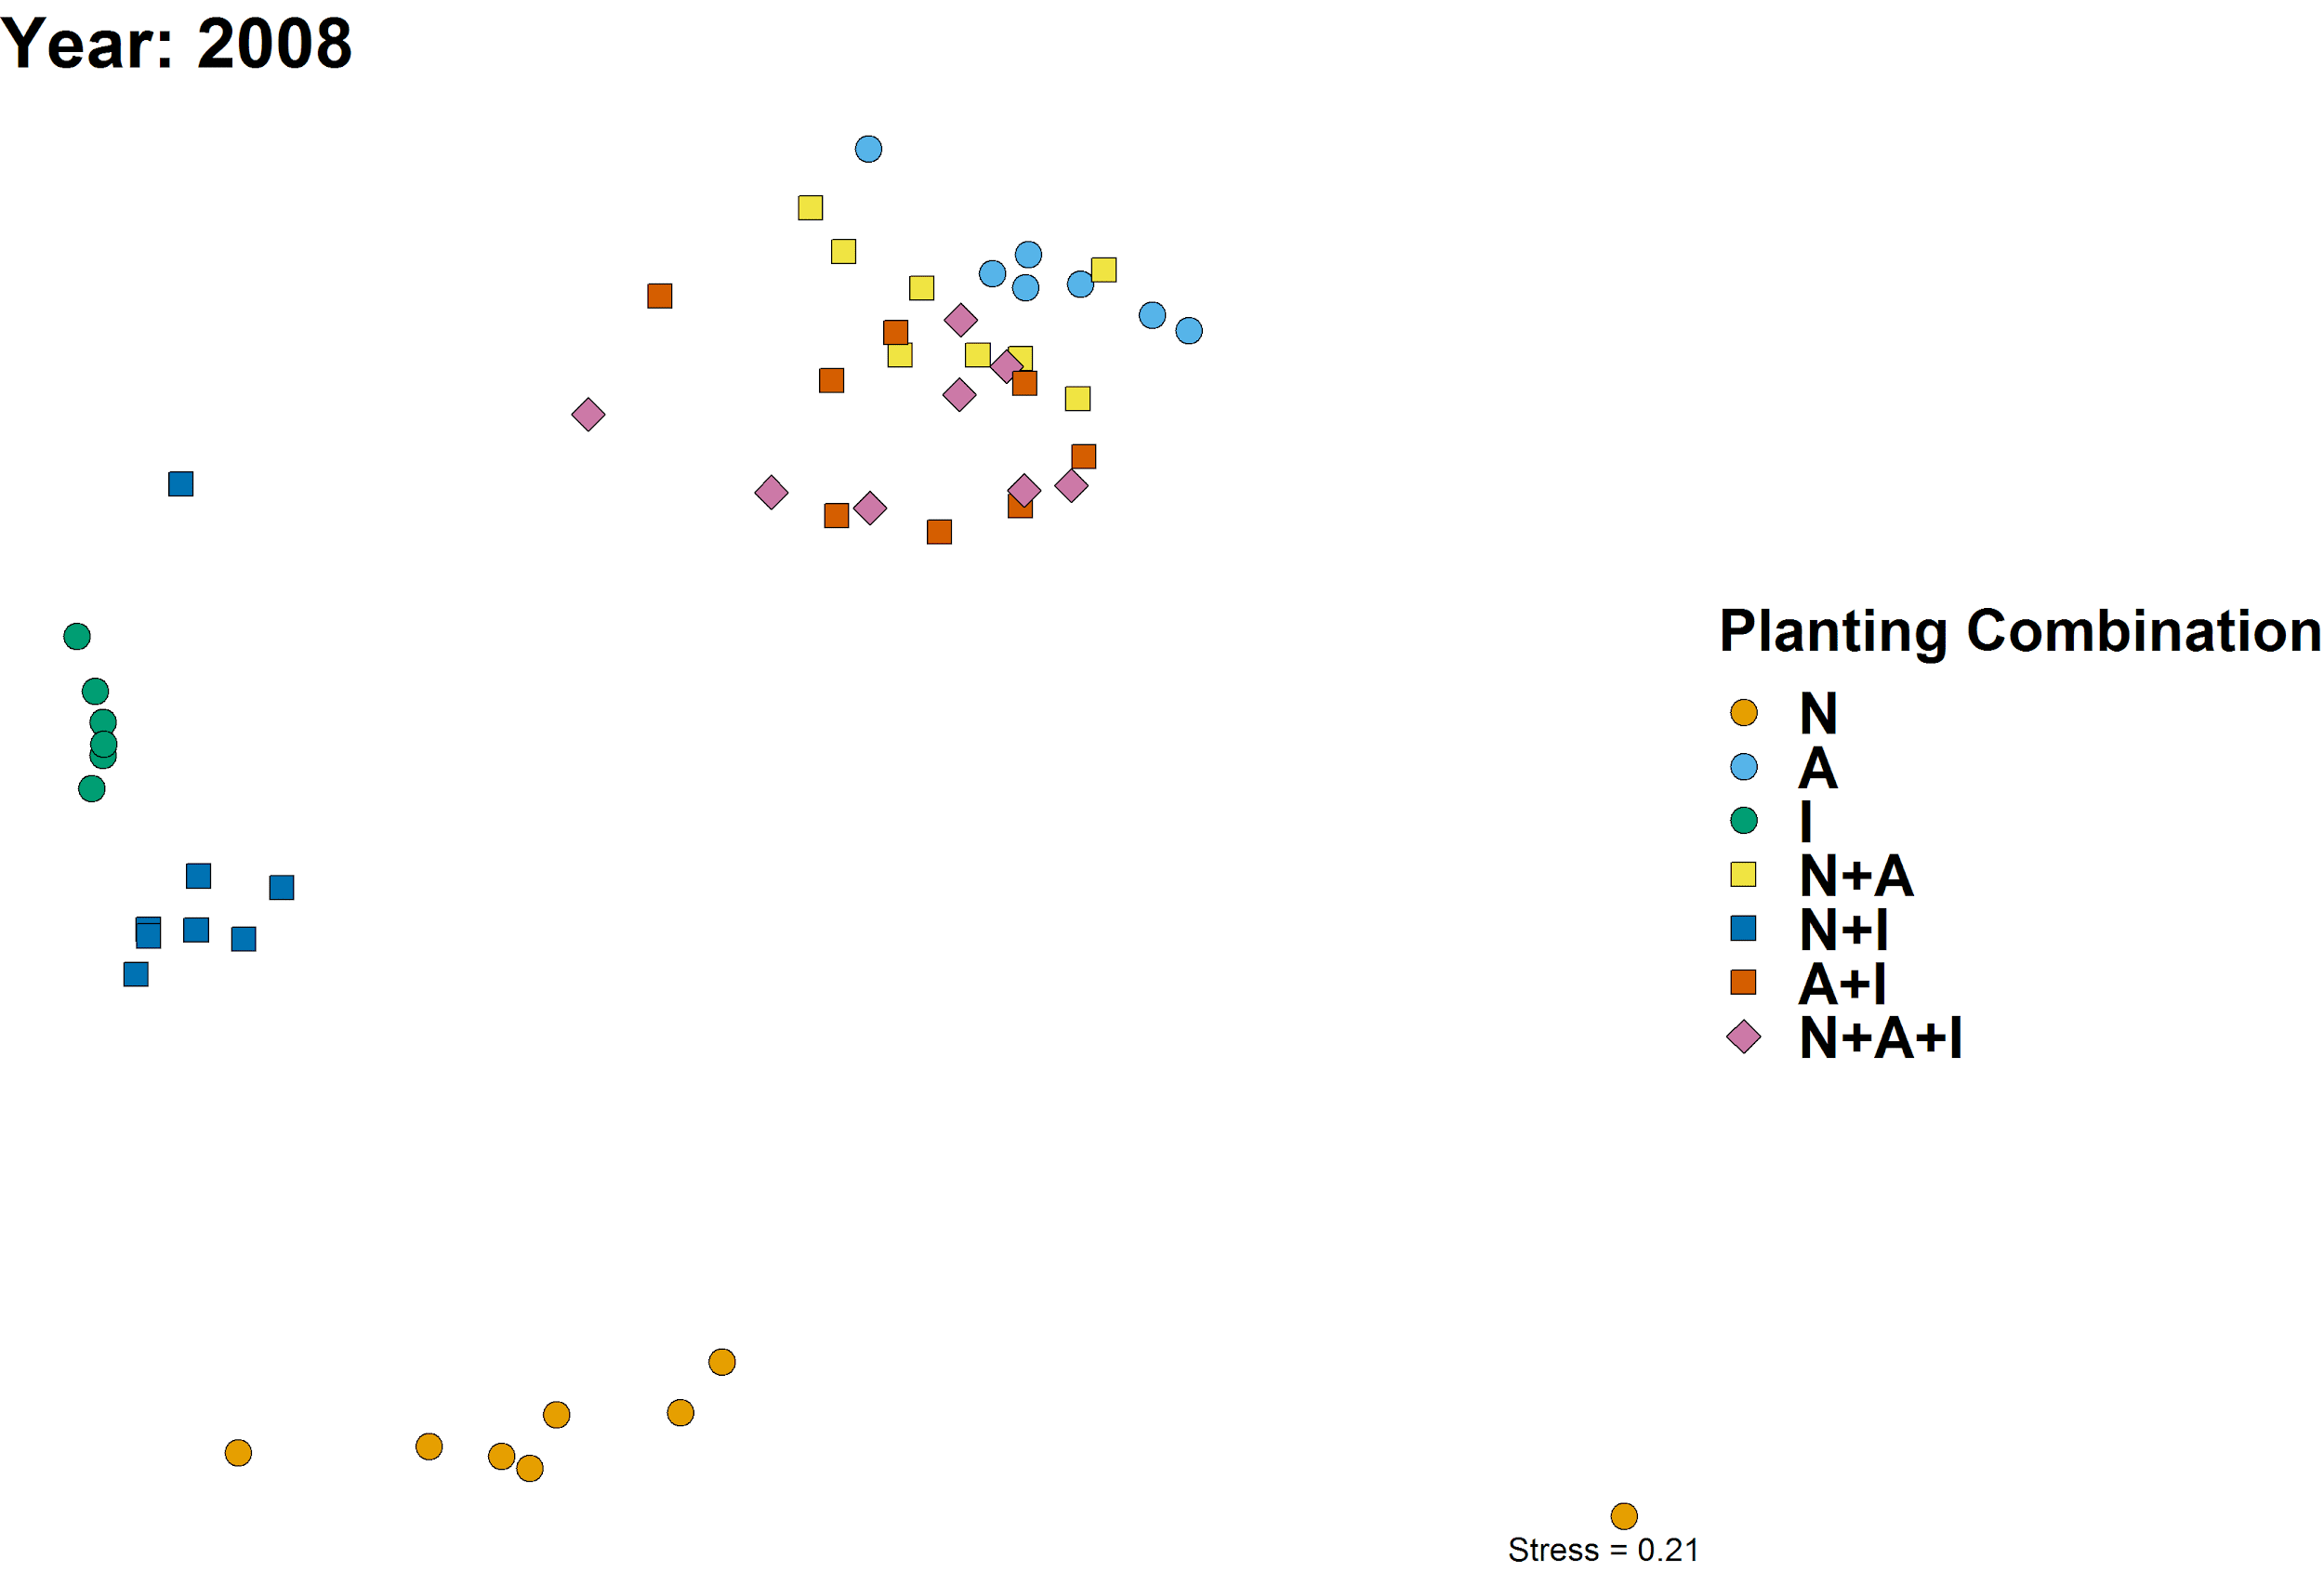
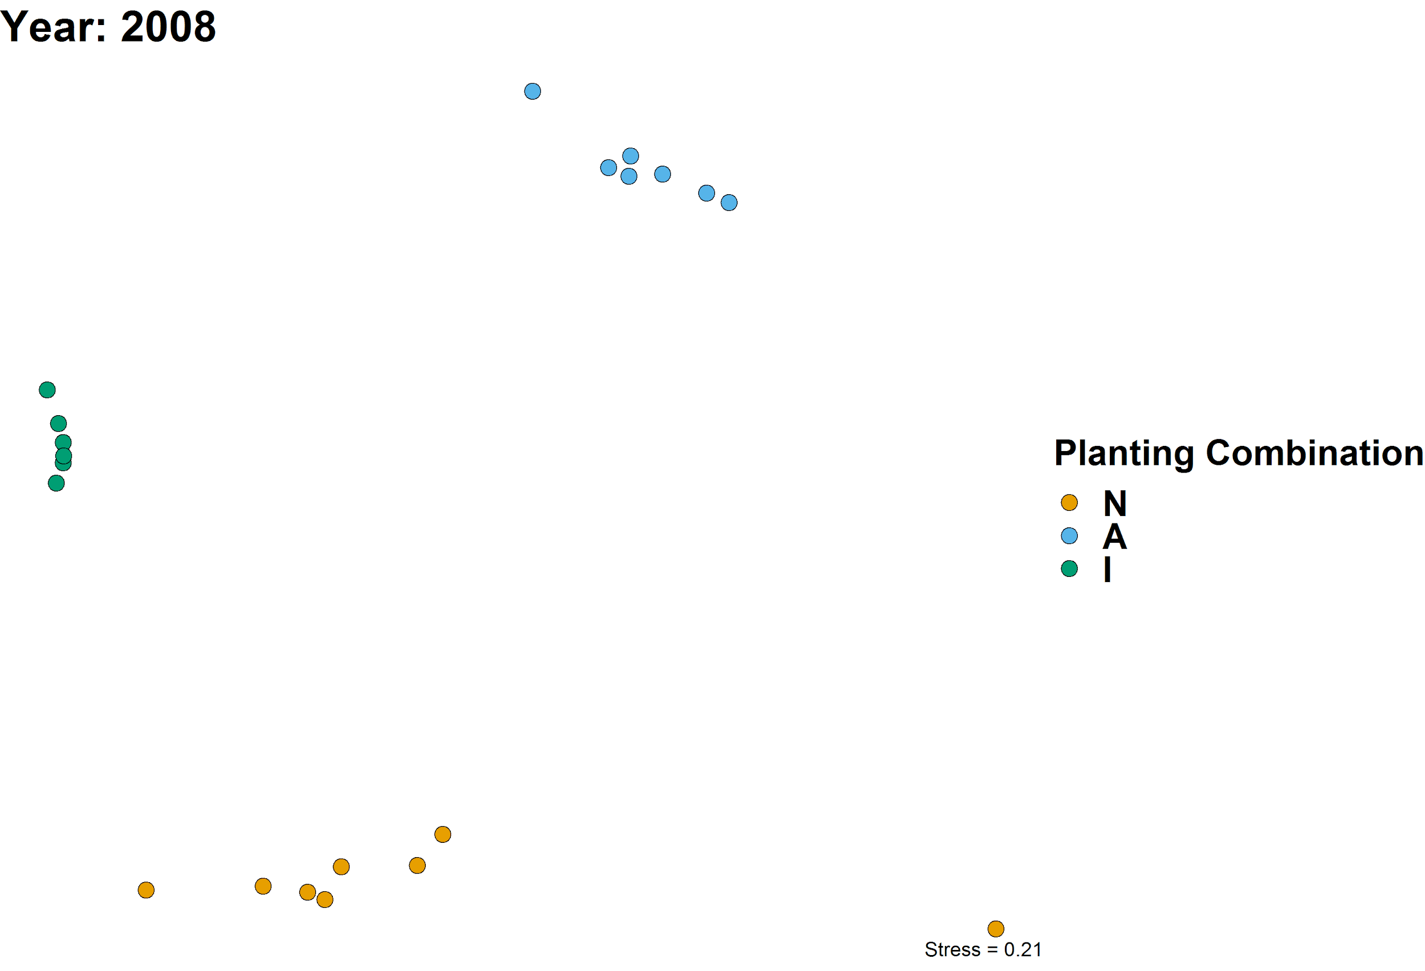
Seeding mixture controls composition in 1st year
Naturalized Annuals
Invasive Species
Native Perennials

Slide 13
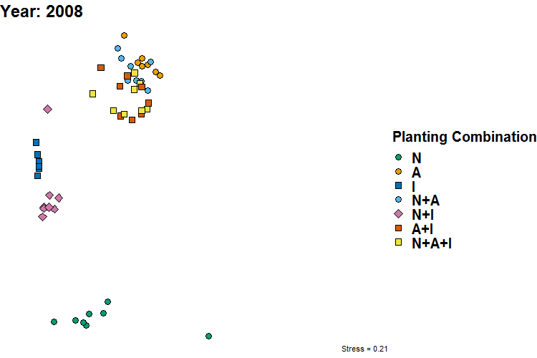
Lack of convergence in vegetation composition

Slide 14
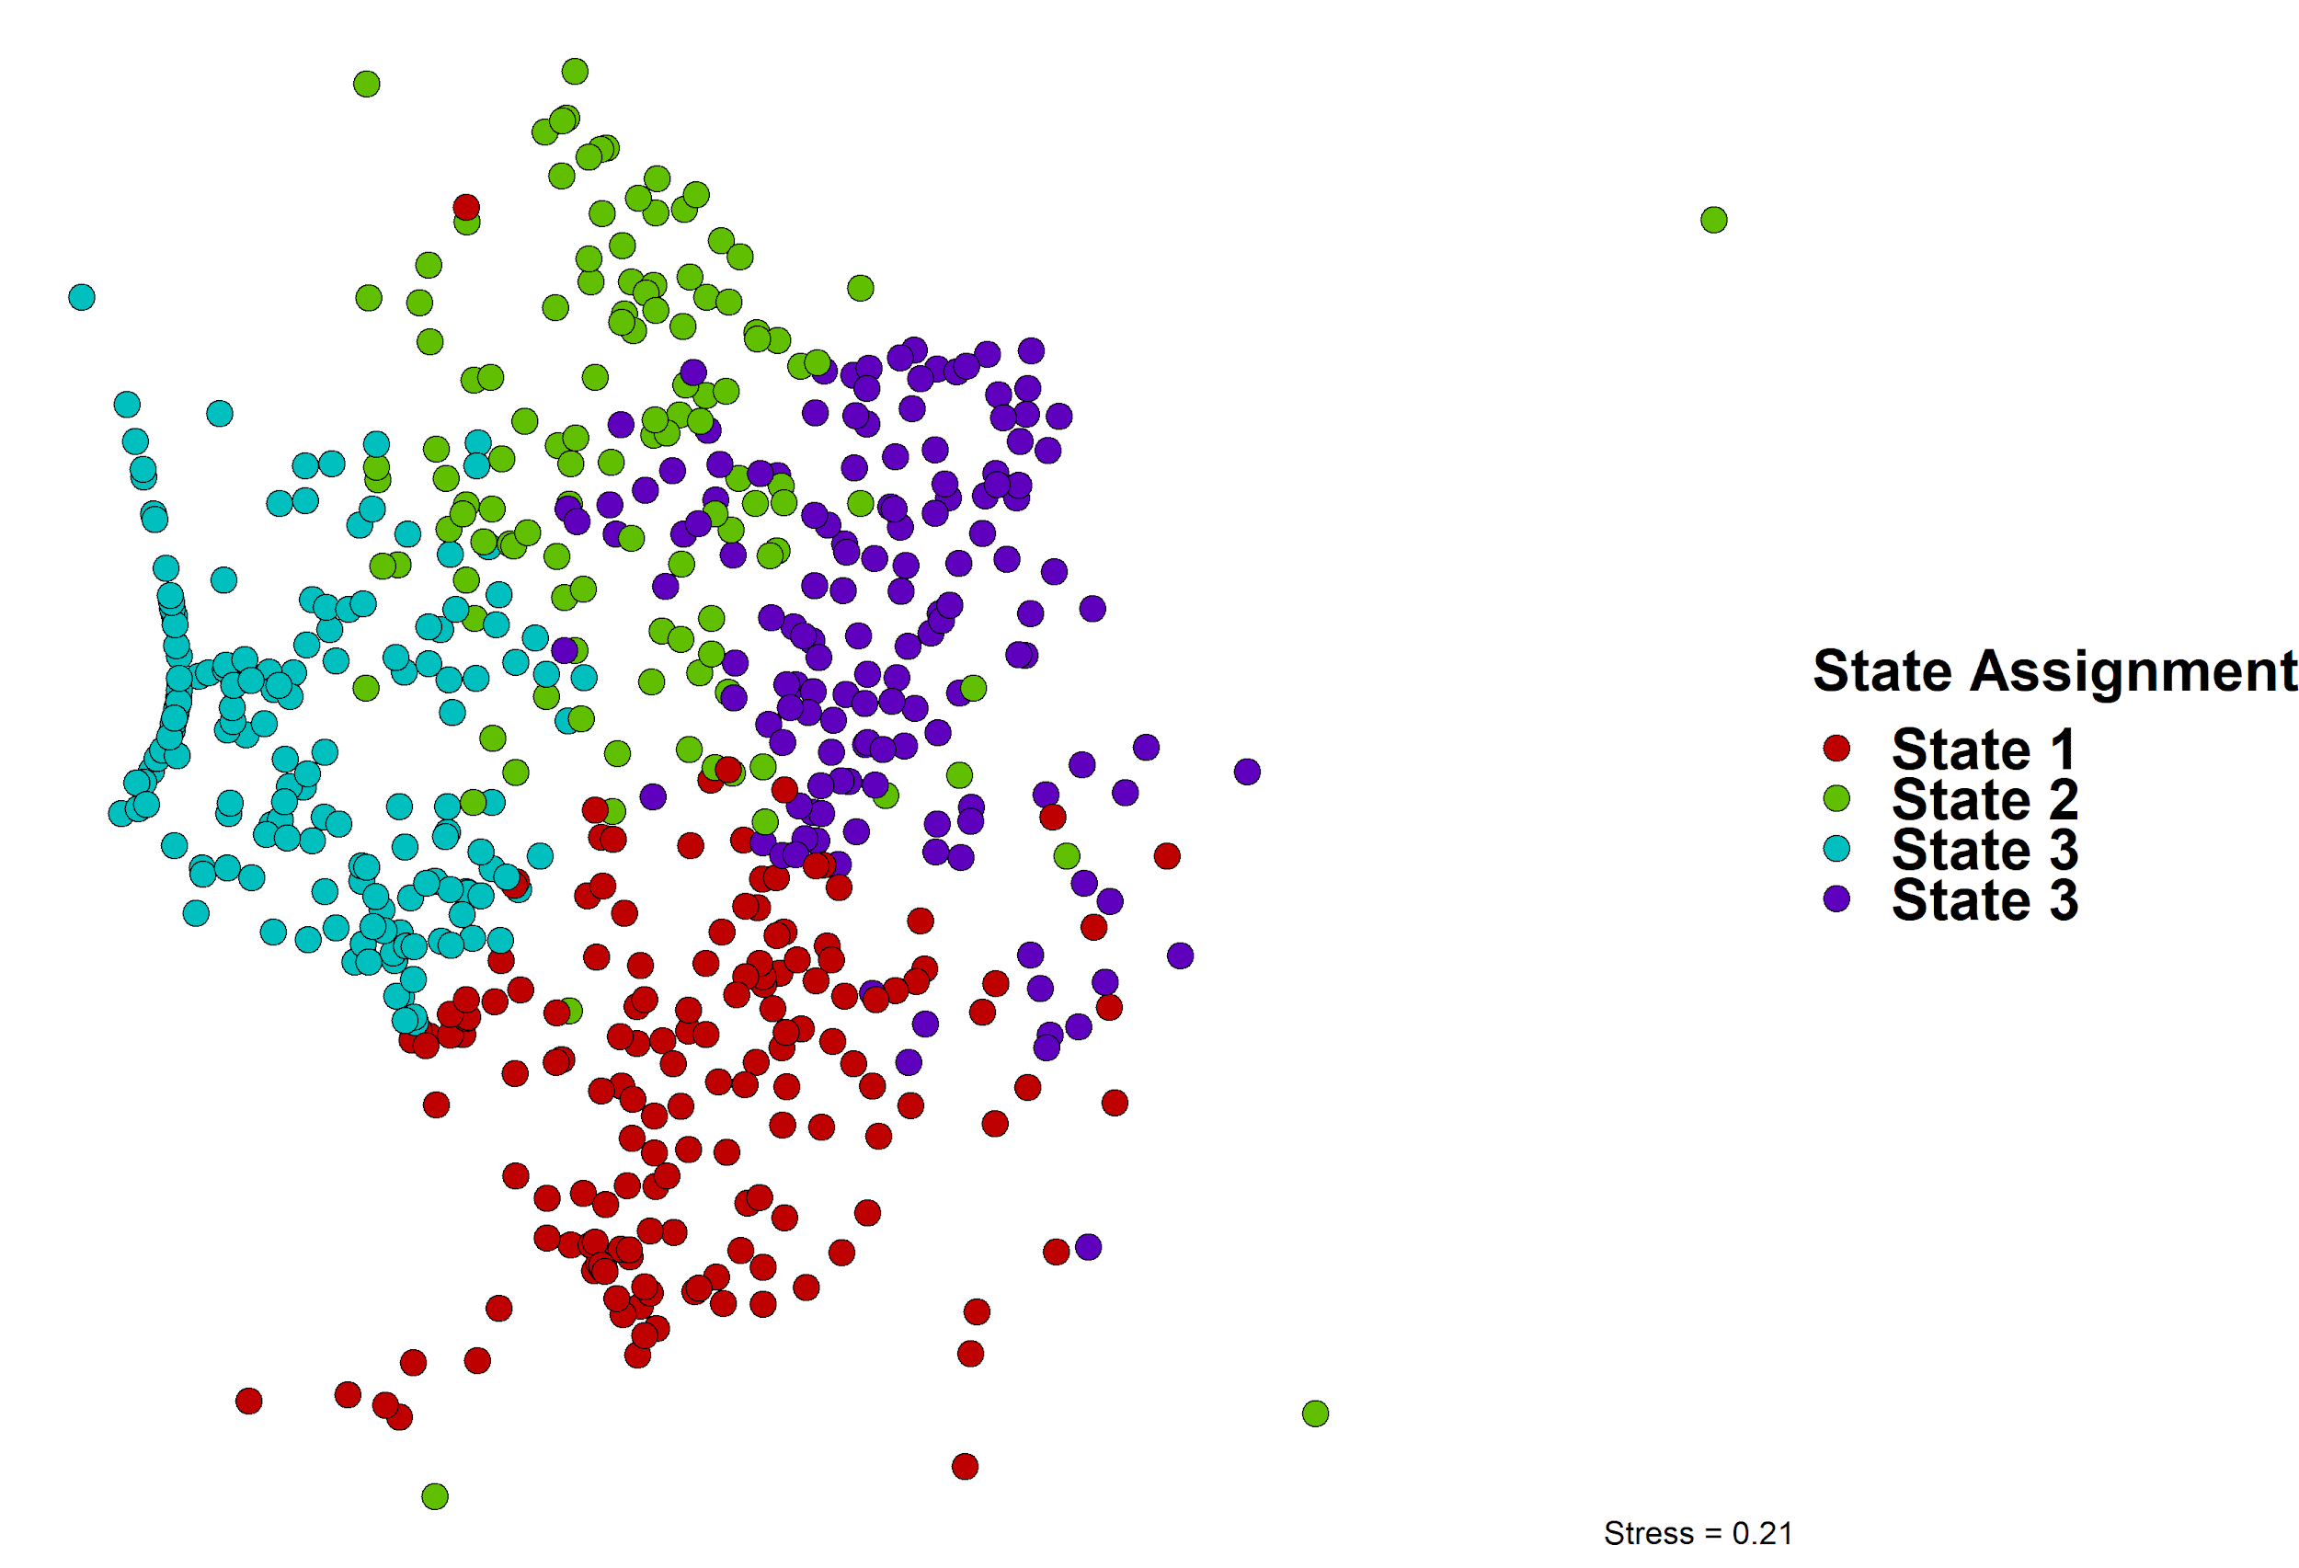
Clustering partitions “naturalized annual” state
State 2
State | Species | Stat | P-val
1 | E. glaucus (N) | 0.801 | 0.001
 | S. pulchra (N) | 0.574 | 0.001
 | B. carinatus (N) | 0.548 | 0.001
 | F. microstachys (N) | 0.284 | 0.001
2 | F. perennis (A) | 0.825 | 0.001
 | B. hordeaceous (A) | 0.723 | 0.001
 | T. subterraneum (A) | 0.607 | 0.001
3 | E. caput-medusae (I) | 0.871 | 0.001
 | A. triuncialis (I) | 0.741 | 0.001
4 | A. fatua (A) | 0.819 | 0.001
 | B. diandrus (A) | 0.553 | 0.001
 | E. triticoides (N) | 0.303 | 0.036
 | A. americanus (N) | 0.274 | 0.011
Naturalized Annuals (Subset)
State 4
Naturalized Annuals (Subset)
4
State 3
Invasive Species
State 1
Native Species

Slide 15
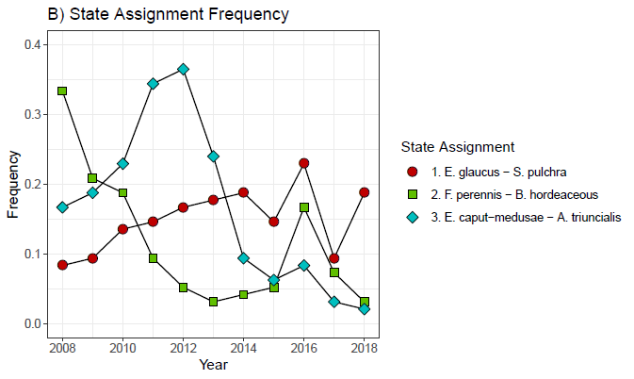
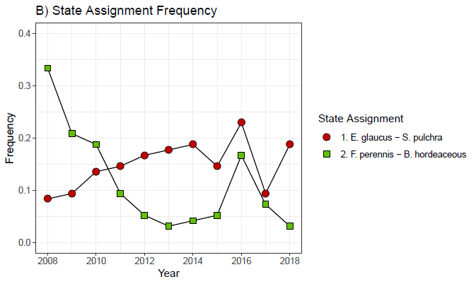
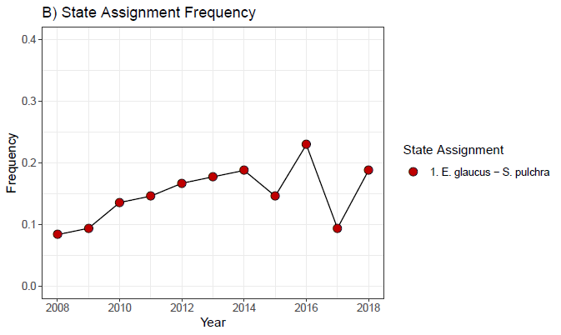
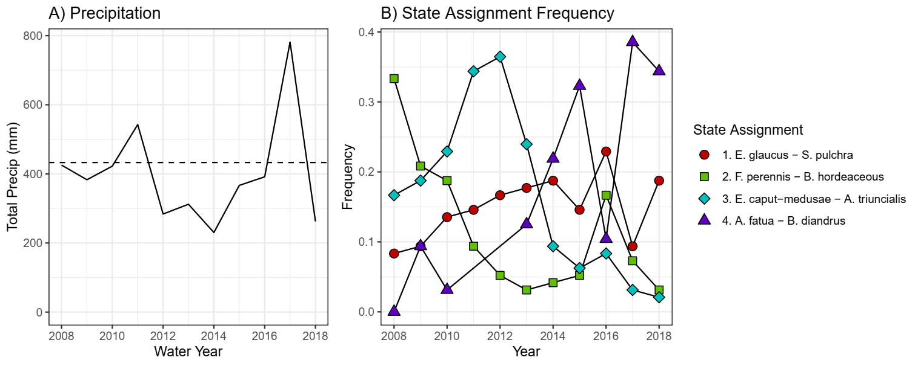
Vegetation state frequency correlates with climate
Drought

Slide 16
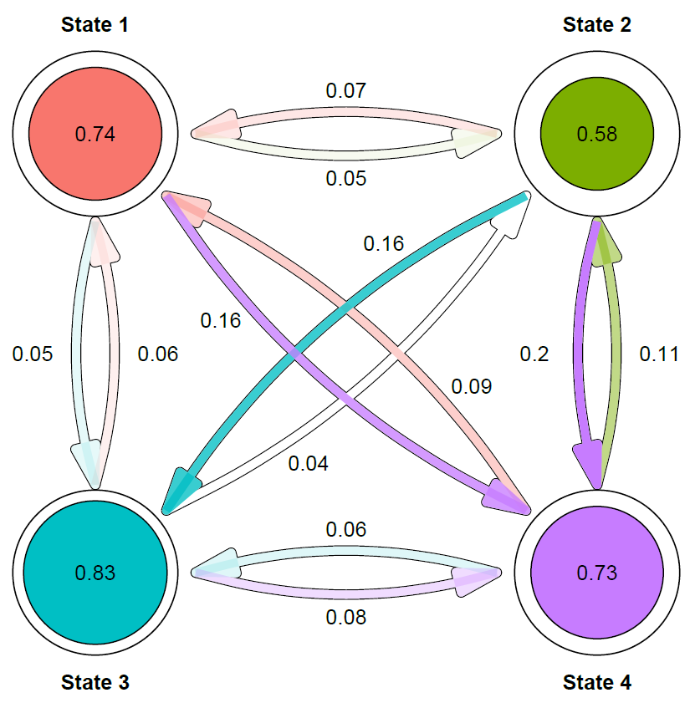
(Native Perennials)
(Naturalized Annuals)
Multi-state model of vegetation transitions
With observed cluster data, we can estimate:
The probability of a community retaining its state over time
The probability of different transitions (and their direction)
With covariates:
Initial planting composition
Drought stress (SPEI)
(Invasive Annuals)
(Naturalized Annuals)

Slide 17
(Native Perennials)
(Naturalized Annuals)
1. Naturalized annual states differed in their stability:
State 2 abundant early in the experiment, largely transient
State 4 important under drought conditions
2. Invasion dynamics illustrated by frequent transitions between State 2 and State 3
3. Native perennial grasses (State 1) highly resistant to invasion once established
(Invasive Annuals)
(Naturalized Annuals)

Slide 18
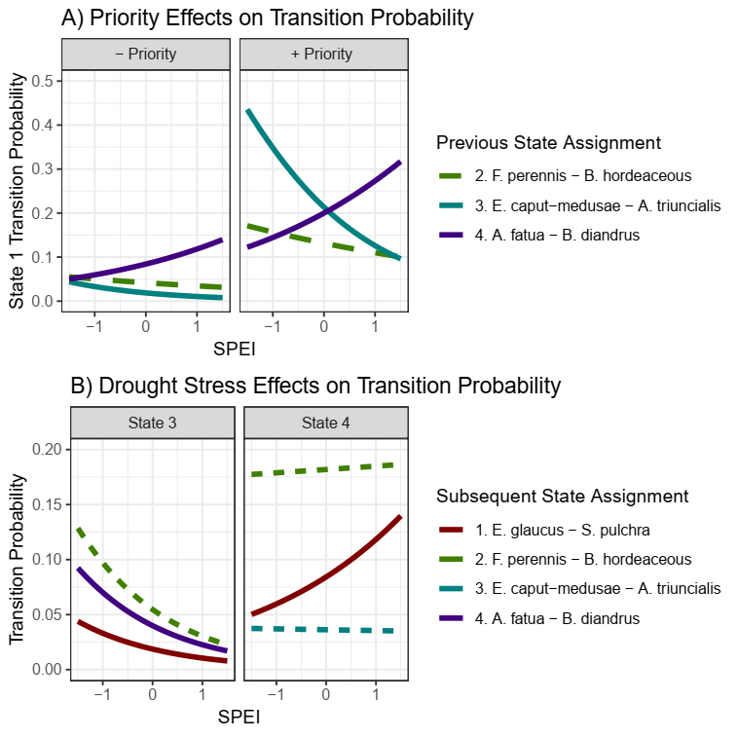
Restoration seeding depends on climate
Highlight stability here
Water Surplus
Severe Drought
P(Transition to Native State)
Transitions to native-dominated states are far more likely when natives are part of the initial seeding mixture, and depended on drought stress

Slide 19
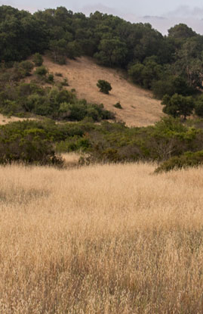
Conclusions
Classic conceptual models may not mirror vegetation performance under novel conditions in California annual grasslands
Climatic variation acts a a major driver of turnover in dominant species groups.
Short-term evaluations may not capture restoration success -- native species only become dominant under certain environmental conditions
Quantitative STMs -- highly adaptable to many systems, output mirrors existing management tools

Slide 20


Acknowledgements
The Eviner Lab:
David Mitchell
Joanne Heraty
Undergraduate interns
Funding Sources:
UC Davis Department of Plant Sciences
UC Davis Graduate Group in Ecology
US Department of Agriculture
Email:
ebatzer@ucdavis.edu
Twitter:
@eebatzer
Website:
www.evanbatzer.com
To see an interactive version of state-transition modeling output, please visit:
ebatzer.shinyapps.io/stm_dynamic

Slide 21
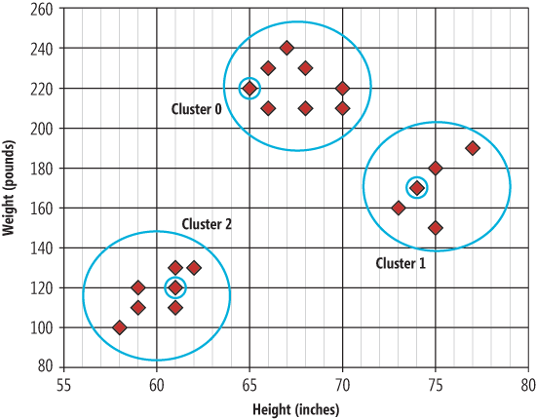
K-medoids clustering
K-medoids Clustering:
Partitional clustering method
Random assignment of “medoids”
Determine groups by similarity to medoid
Swap medoid, repeat until optimum
Appropriate Number of Clusters:
Subjective task, to some degree
Apply a battery of heuristics to K-medoids solutions
K = 2, 3, ...,10 groups
Silhouette, Hartigan, Beale, etc.
Select clustering solution with best performance over all heuristics
Simplified K-medoids example
Source: https://msdn.microsoft.com/en-us/magazine/jj891054.aspx

Slide 22
Multi-state model output
State Transition Probability |  |  | Covariate Hazard Ratios
Assignment | Transition | Probability | Temporal Priority | Drought Stress (SPEI)
State 1 | State 1 | 0.74 (0.65,0.8) | - | -
 | State 2 | 0.05 (0.03,0.08) | 4.77^ | 0.8
 | State 3 | 0.05 (0.03,0.1) | 2.96 | 0.95
 | State 4 | 0.16 (0.11,0.23) | 1.53 | 0.86
State 2 | State 1 | 0.07 (0.04,0.11) | 3.31^ | 0.83
 | State 2 | 0.58 (0.48,0.65) | - | -
 | State 3 | 0.16 (0.11,0.23) | 1.71 | 1.41
 | State 4 | 0.2 (0.14,0.27) | 0.54 | 0.71
State 3 | State 1 | 0.06 (0.03,0.11) | 12.74** | 0.56*
 | State 2 | 0.04 (0.02,0.07) | 0.55 | 0.55^
 | State 3 | 0.83 (0.75,0.88) | - | -
 | State 4 | 0.08 (0.05,0.12) | 3.26* | 0.56*
State 4 | State 1 | 0.09 (0.06,0.15) | 2.53* | 1.43*
 | State 2 | 0.11 (0.08,0.17) | 0.77 | 1.02
 | State 3 | 0.06 (0.04,0.11) | 1.93 | 0.98
 | State 4 | 0.73 (0.65,0.79) | - | -
Parameter estimates of the best fit multi-state model (Model 6; Table 3). For each state assignment, potential state assignments in subsequent years (“Transitions”) and their associated probabilities (+/- 95% confidence intervals) are reported.
Effects of covariates are reported as hazard ratios, the relative rate a transition will occur relative to control. In this case, temporal priority hazard ratios refer to the rate a plot transitions to a state assignment represented in a plot’s initial seeding mixture; drought stress hazard ratios reflect the rate a plot transitions to a given state assignment per unit increase in SPEI.
Statistically significant (p < 0.05)
^ p < 0.01; * p < 0.05; ** p < 0.01

